Slide 1
COMP 3069
Computer Graphics
Lecture 4:
Hierarchical Modelling
Autumn 2018

Slide 2
Today’s Content
OpenGL transformation matrix stacks
  Store transformation matrices
Push/pop transformation matrix stack
  Save current scene state for come back later
Hierarchical modelling
  Creating complex object/scene
Pixar lamp modelling, animation, and demo

Slide 3
OpenGL Matrix Stacks
There are 3 transformation matrix stacks:
  Model-View - glMatrixMode(GL_MODELVIEW);
  Projection - glMatrixMode(GL_PROJECTION);
  Texture - glMatrixMode(GL_TEXTURE);
In Model-View mode, an identity matrix is created, which becomes the ‘current matrix’ and sits on top of the matrix stack
When another transformation is called in the program, the current matrix is updated, e.g., multiplied (from the right) by the new matrix corresponding to the transformation called.

Slide 4
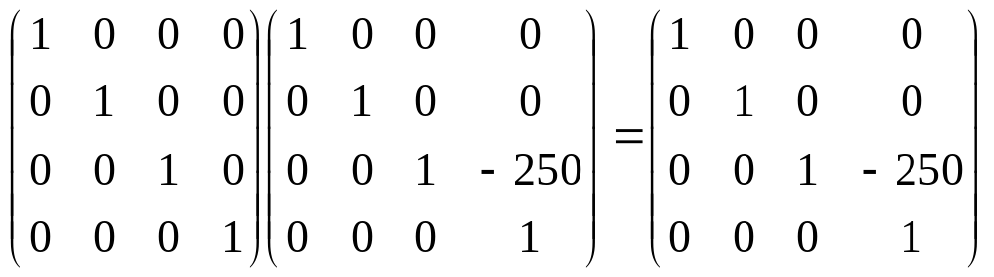
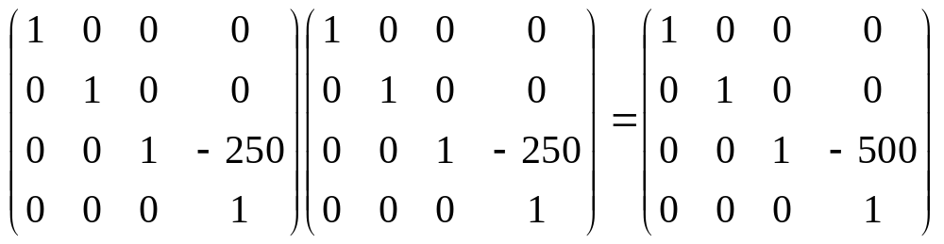
OpenGL Matrix Stacks
Say you call glMatrixMode(GL_MODELVIEW)
If you then call glTranslatef(0,0,-250), the current matrix will be
If you call glTranslatef(0,0,-250) again, current matrix will be:
If you then call DrawCube() – the cube will be drawn at a distance of 500 from the origin, in the -Z direction

Slide 5
Push/Pop Matrix Stacks
If at some point you need to do something somewhere in your object / scene, but you know you will be back to the current position later on, you should call glPushMatrix(), which will make a copy of the current matrix and push it on top of the matrix stack.
When you are ready to go back to where you were, you should use glPopMatrix(), which will ‘pop’ the saved matrix off the stack, and you are back where you were.

Slide 6
Push/Pop Matrix Stacks
I * T
I * T
The modelling stack in action:
  glTranslatef(10,0,0);
  glPushMatrix();
    glTranslatef(10,0,0);
    glRotatef(45,0,1,0);
  glPushMatrix();
    glRotatef(45,0,1,0);
  glPopMatrix();
  glPopMatrix();
I * T
I * T * T
I * T
I * T * T * R
I * T
I * T * T * R
I * T * T * R
I * T
I * T * T * R * R
I * T * T * R
I * T

Slide 7
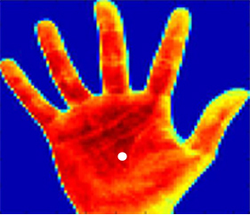
Using glPushMatrix / glPopMatrix
Say you are at the centre of the palm (CoP)
glPushMatrix() saves a copy of current matrix
Rotate and translate to draw thumb as a cylinder
glPopMatrix() so you are at the CoP again
glPushMatrix() to save a copy of current matrix
Rotate and translate to draw index finger
glPopMatrix() so you are at the CoP again, to draw middle finger ..

Slide 8

Using glPushMatrix / glPopMatrix
The lamp has a base, a10 inch lower arm and a 10 inch upper arm, and a head.
DrawBase();
glTranslated(0.0, 5.0, 0.0);
DrawArm();
glTranslated(0.0, 10.0, 0.0);
DrawArm();
glTranslated(0.0, 5.0, 0.0);
glRotated(-25.0, 0.0, 1.0, 0.0);
DrawHead();

Slide 9

DrawBase();
glTranslated(0.0, 5.0, 0.0);
DrawArm();
glTranslated(0.0, 5.0, 0.0);
glPushMatrix();
glTranslated(5, 0.0, 0.0);
glRotated(-50.0, 0, 0, 1);
DrawArm();
glPopMatrix();
glPushMatrix();
glTranslated(-5, 0.0, 0.0);
glRotated(50.0, 0, 0, 1);
DrawArm();
glPopMatrix();
glTranslated(0.0, 5.0, 0.0);
DrawArm();
glTranslated(0.0, 5.0, 0.0);
glRotated(-25.0, 0.0, 1.0, 0.0);
DrawHead();

Slide 10
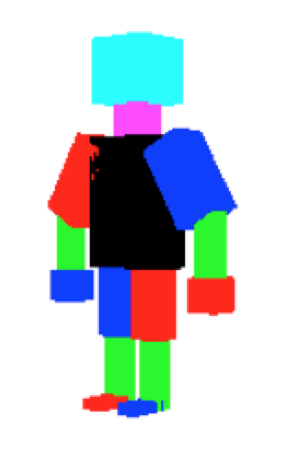
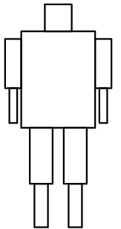
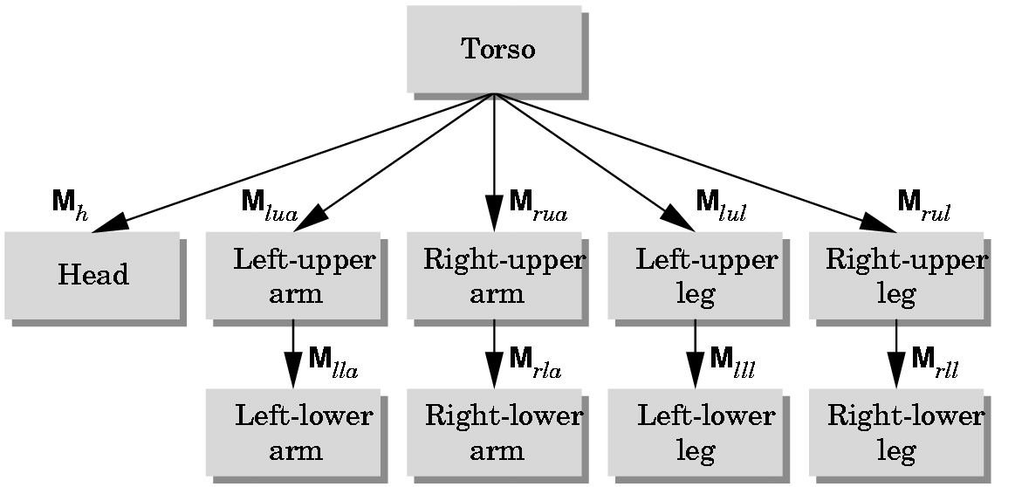
Hierarchical Modelling
Root node
An arc
  Human body is hierarchical, with body, head, upper arm, lower arm, etc…

Slide 11
Hierarchical Modeling
Scene
Robot
Ball
Arm
Arm
Wheels
UpperArm
Wheel
Wheel
LowerArm
Hand
Finger
Finger

Slide 12
Data Structure for
Hierarchical Modelling
Generally represented as a tree, with nodes and arcs
A node is a link or a part of the object
An arc contains transformation to be applied to the node, and the rest of the linkage further down the hierarchy
It is convenient to define points in the local coordinate system associated with a joint and to have a method for converting the coordinates of a point from one system to another

Slide 13
Data Structure for
Hierarchical Modelling
link₁
link_{1.1}
link₀
T₀
θ_{1.1}
Data for link₀
T1 transforms link1 relative to link0
θ₁
R₁(θ₁)
Data for link₁
T₀
T1.1 transform link1.1 relative to link1
R_{1.1}(θ_{1.1})
Data for link_{1.1}

Slide 14
Kinematics
Kinematics is the study of object movements irrespective of their speed or style of movement
Forward kinematics traverses the tree structure and propagates transformations downward - vertex of an object can be transformed by concatenating all transformations higher up in the tree and applying the composite transformation to the vertex. High DOF models are tedious to control this way
Inverse kinematics provides a "goal-directed" approach to animating a character, e.g., given the position of an object, how to configure the robot arm to reach that object

Slide 15
Keyframe Animation Techniques
Commonly used and easier than kinematics.
Artist draws the major frames of the animation.
Major frames are the ones in which prominent changes take place. Animator specifies critical or key positions for the objects, and speed of animation etc.
The computer then automatically fills in the missing frames by smoothly interpolating between those positions.

Slide 16
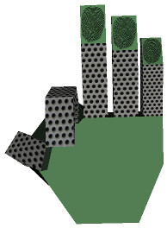
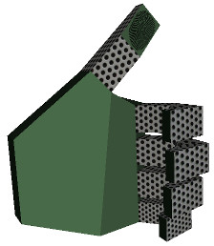
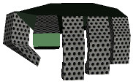
Interpolation-based:
Keyframe Animation
The keyframe of a model contains information such as the model's structure, position, orientation, and scale, e.g., 3 key frames:

Slide 17
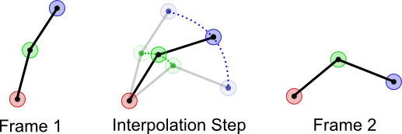
Interpolation based:
Keyframe Animation
Suppose we have two keyframes that contain a bone structure with three joints (red, green and blue vertices)
We render frame one, then an intermediate scene (obtained through interpolation) before rendering frame two for a more smooth animation flow
p1
p
α
1-α
p2
e.g., linear interpolation: p = (1-α) p1 + α p2

Slide 18
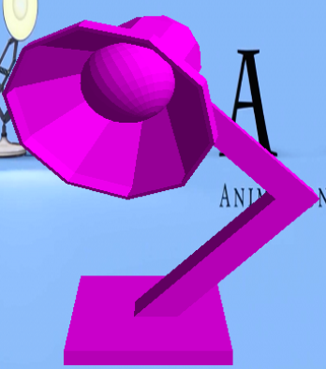
void Lamp::Update( const double& deltaTime )
{
if( animateTime < 1.0 ) {
if( keyframe != 0 ) {
keyframe = 0;
animateTime = 0.0;
animateRotation = 0.0;
animateTranslation = 0.0;
interpA = -45.0;
interpB = -60.0;
interpTime = 1.0;
}
}//have now interpolated to keyframe 1
else if( animateTime < 1.25 )
{
if( keyframe != 1 ) {
keyframe = 1;
animateRotation = 0.0;
interpA = -60.0;
interpB = -15.0;
interpTime = 0.25;
}
animateTranslation = -(4.0*9.81)*(animateTime-1.0) + 0.5*(animateTime-1.0)*(animateTime-1.0)*(4.0*GRAVITY);
} // have now interpolated to keyframe 2
else {
if( keyframe != 2 ) {
keyframe = 2;
animateRotation = 0.0;
interpA = -15.0;
interpB = -45.0;
interpTime = 1.75;
}
animateTranslation = -(4.0*9.81)*(animateTime-1.0) + 0.5*(animateTime-1.0)*(animateTime-1.0)*(4.0*GRAVITY);
}
}

Slide 19

gluLookAt(0.0, 5.0, 0.0, 0.0, 0.0, -50.0, 0.0, 1.0, 0.0);
glTranslated(0.0, 0.0, -500.0);
glScalef(12.0, 12.0, 12.0);
glTranslated(0, -25.0+animateTranslation, 0.0); // for jumping up and down
DrawBase();
// the 1st (negative) rotation point is at the centre of the base, the start of the lower arm
glRotated( interpA + animateRotation*((interpB-interpA)/interpTime ), 0.0, 0.0, 1.0);
glTranslated(0.0, 7.0, 0.0); // move to the centre of the lower arm
DrawArm(); // draw the lower arm
// move to the 2nd (positive) rotation point, from the centre to the end of the lower arm
glTranslated(0.0, 7, 0.0);
glRotated(2.0*( - ( interpA + animateRotation*((interpB-interpA)/interpTime ) ) ), 0.0, 0.0, 1.0);
glTranslated(0.0, 7.0, 0.0); // move to the centre of the upper arm
DrawArm();
glRotated(-25.0, 0.0, 1.0, 0.0);
glTranslated(0.0, 5.0, 0.0);
DrawHead();

